Slide 1


The Patient Experience Following Medical Harm

Slide 2


MITSS Survey
Anonymous – attached to MITSS website
293 started, and 219 completed survey
Respondents from 40 states/7 countries
Primarily female (94.5%)
Age range from teens to 80’s – 64% in 40’s/50’s
Most report being patients (64%)

Slide 3
Top 6 Self-Reported Experiences Following Adverse Events

Slide 4
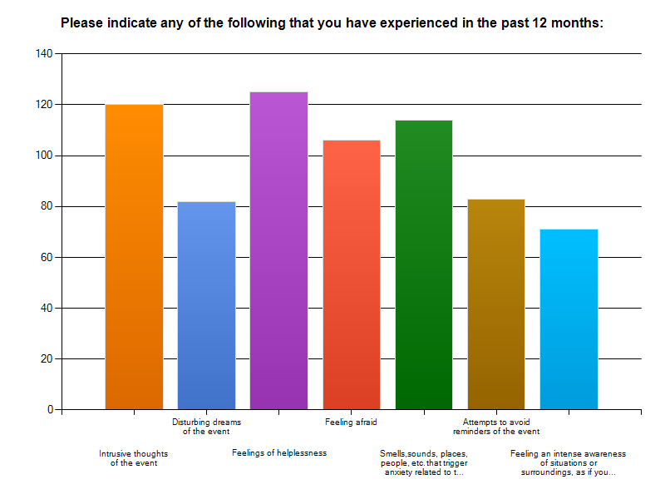

Long Term Effects
Time elapsed since event:
1 year or less 31%
2-5 years ago 37%
6-10 years ago 16%
>10 years ago 15%
N=221

Slide 5
Communication Following Event
Only 40% reported fully understanding details of event.
78.4% reported NOT receiving an apology.
Of those who received an apology, 63% felt the apology was NOT sincere.
86% reported NO referral to support services.

Slide 6


CARe: A Strategy for Addressing Adverse Events Compassionately
Mass Coalition 15th Anniversary – May 20, 2013

Slide 7
CARe and MACRMI
Communication, Apology, and Resolution:
an approach for healthcare systems and liability insurers to respond to adverse events and resolve cases of preventable harm.
Objectives:
  Improve communication and transparency
  Support patients and families
  Support clinicians
  Improve patient safety
  Provide an alternative to lawsuits
  MACRMI: Massachusetts Alliance for
  Communication and Resolution following Medical Injury
Notes:
Improve communication and transparency about adverse outcomes.
Support patients and families to help achieve a fair, timely and healing resolution to medical harm.
Support clinicians in disclosing unexpected outcomes to patients.
Improve patient safety by learning from errors and near misses and preventing future harm.
Provide an alternative to lawsuits and their unnecessary costs by meeting the financial needs of injured patients and their families quickly in the aftermath of an injury, without resorting to litigation.

Slide 8
Challenge and Lessons Learned
Challenge: Educate clinicians and patients so that CARe can be activated when needed and result in effective resolution
Lessons Learned:
  Plan a thorough internal education strategy centering on communication coaching resources
  Involve patients and gather feedback, particularly in patient-facing CARe informational materials

Slide 9

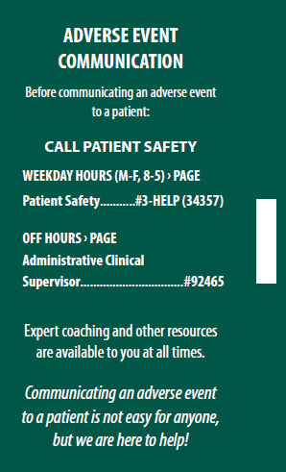
Internal Educational Strategy
Well-planned educational presentations
  20+ different departmental groups
Central pager (3-HELP)
Tangible Reference Materials
Portal Improvements
  Additional reporting links
  Story highlighting the process
Notes:
Use education to allay the fears of change.
Well thought out talking points regarding the benefits for clinicians were very helpful in easing clinicians’ fears about the new program.
What was the one take-away for clinicians? PAGE THIS NUMBER WHEN THERE IS AN ADVERSE EVENT. Why? Just in time coaching, each situation is difficult, education about the program important but not paramount, used rarely.

Slide 10

The Patient Perspective
Involve Patient and Family Advisors, as well as other patient advocates
  Patient Brochure/Website text
Patient Self-Reports of Concerns
Notes:
Communication to/with story from PFAC; Talk about Patient Relations calls being the first tip that something may have been wrong

Slide 11

MITSS

